Slide 1


Alan Trapenard
January 30, 2024

Slide 2

Outline
Executive Summary
Introduction
Methodology
Results
Conclusion
Appendix

Slide 3
Executive Summary
Summary of methodologies
Data Collection from SpaceX API
Data Collection through Web Scraping
Data Wrangling
EDA with SQL
EDA with Data Viz
Geospatial Analytics with Folium
Machine Learning Predictive Modelling
Summary of all results
EDA Result
Interactive Analytics
Predictive Analysis Result

Slide 4
Introduction
Project background and context
SpaceX advertises Falcon 9 rocket launches on its website with a cost of $62 Million; other providers cost upward of $165 Million each, much of the savings is because SpaceX can reuse the first stage. Therefore if we can determine if the first stage will land, we can determine the cost of a launch. This information can be sued if an alternate company wants to bid against SpaceX for a rocket launch
Problems you want to find answers
What factors determine if the rocket will land successfully?
The interaction amongst various features that determine the success rate of first stage landing
What operating conditions need to be in place to ensure a successful landing.

Slide 5

Section 1

Slide 6
Methodology
Executive Summary
Data collection methodology:
Data was collected using the SpaceX API
Data was also collected, using Web Scraping techniques, from Wikipedia.
Perform data wrangling
One-hot encoding (dummy coding) was applied to categorical feature

Slide 7
Methodology
Executive Summary
Perform exploratory data analysis (EDA) using visualization and SQL
Perform interactive visual analytics using Folium and Plotly Dash
Perform predictive analysis using classification models
Split data into training and testing batches
Built models (Decision Tree, SVM, and Logistic Regression)
Utilized Cross Validation in a Grid Search style to check for best hyperparameters
Select model with best accuracy score

Slide 8
Data Collection
Data Collection Method 1: SpaceX API and SQL
GET Request to SpaceX API
Decoded response as JSON Object using .json() function -> Turn into Pandas DataFrame using .json_normalize()
Necessary data cleaning (check for missing values and fill in missing data)
Data Collection Method 2: Web Scraping
Wikipedia Web Scraping for Falcon 9 launch records using BeautifulSoup
Objective: Extract launch records, parse the table objects, convert to DataFrame for further analysis/visualization

Slide 9
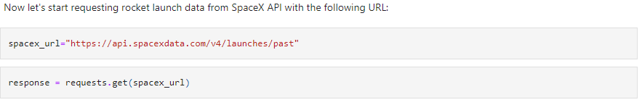
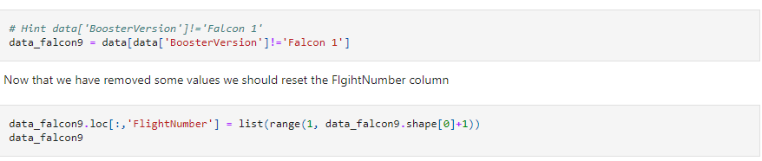
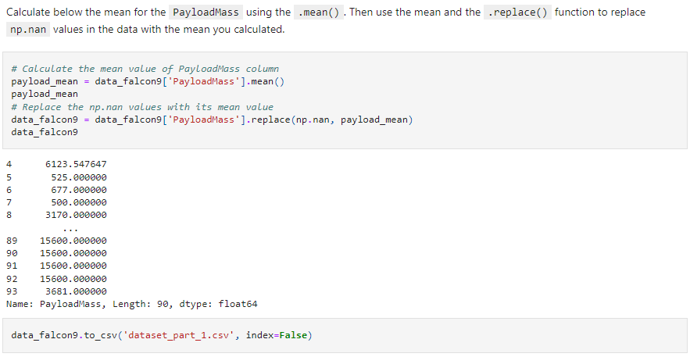
Data Collection – SpaceX API
GET Request to SpaceX API -> Basic Wrangling/Formatting -> Further filtering/cleaning to isolate necessary data
The link to the notebook is: https://github.com/ATrapenard/IBM_AppliedDataScience_Capstone/blob/main/jupyter-labs-spacex-data-collection-api.ipynb
Place your flowchart of SpaceX API calls here

Slide 10
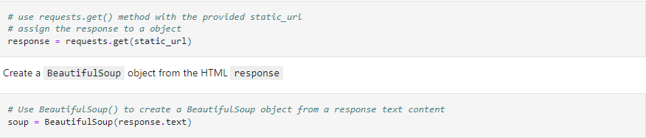
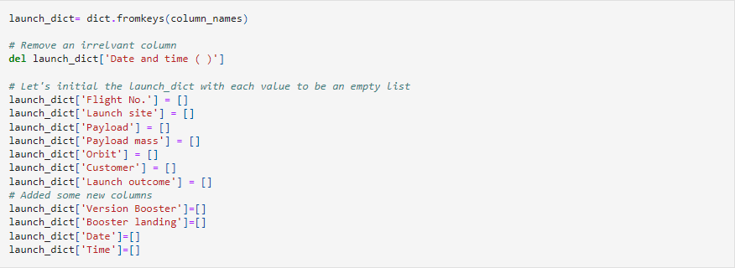
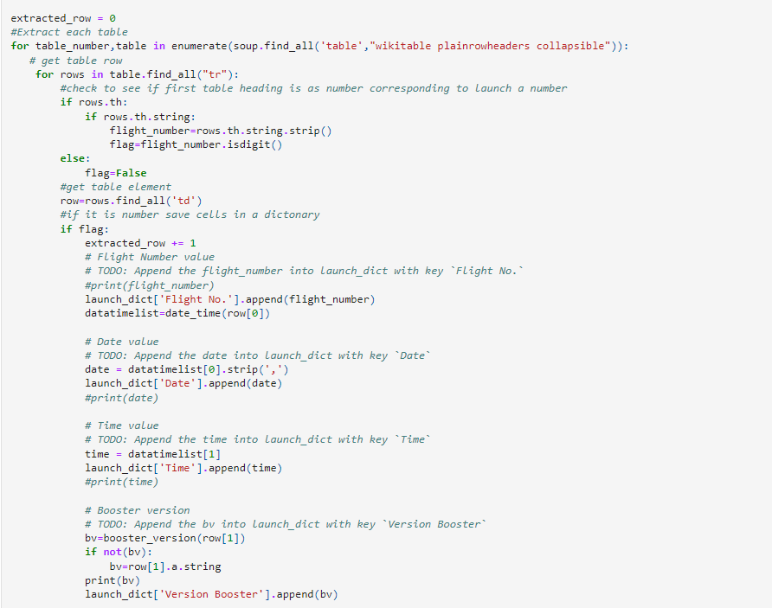
Data Collection - Scraping
Wikipedia Scraped HTML -> BeautifulSoup Object -> Parse Tables to Dict-> Pandas DataFrame
The link to the notebook is: https://github.com/ATrapenard/IBM_AppliedDataScience_Capstone/blob/main/jupyter-labs-webscraping.ipynb
Place your flowchart of web scraping here

Slide 11
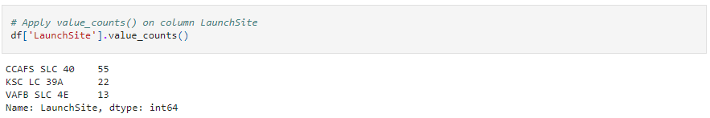
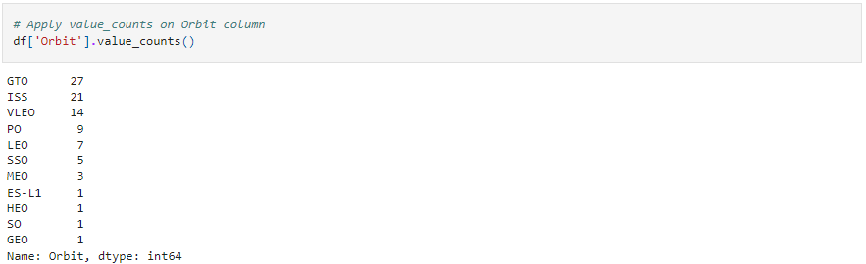
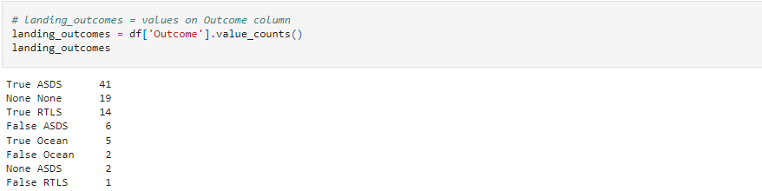
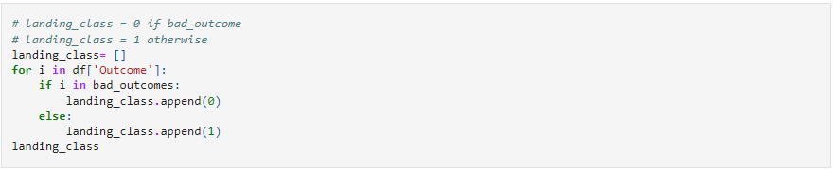
Data Wrangling
Summary information on Orbits and Launch Sites -> Summary information on Landing Outcomes -> Create new ‘Class’ Feature for subsequent analysis
The link to the notebook is: https://github.com/ATrapenard/IBM_AppliedDataScience_Capstone/blob/main/labs-jupyter-spacex-Data%20wrangling.ipynb

Slide 12
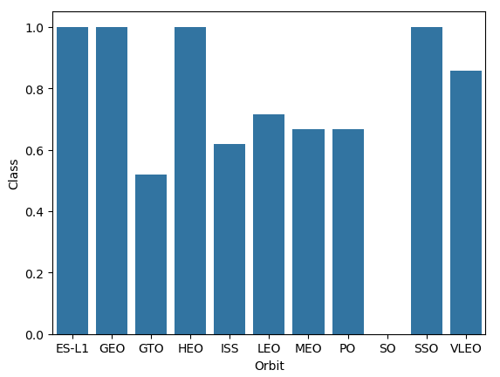
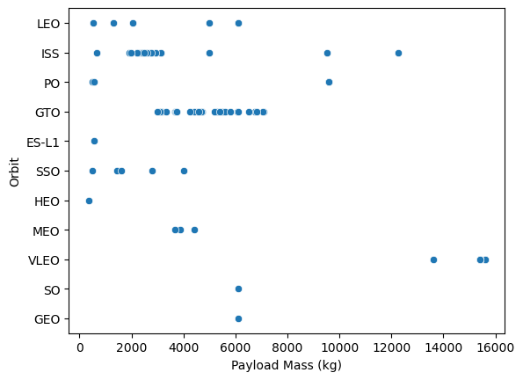
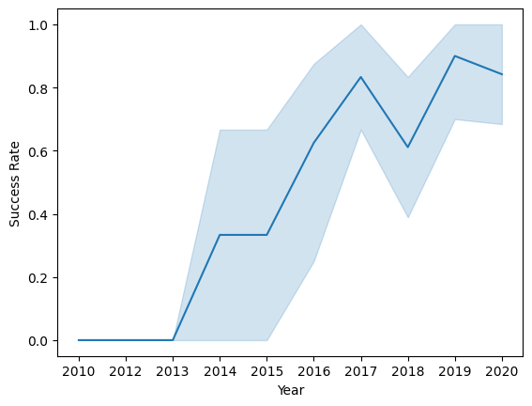
EDA with Data Visualization
The link to the notebook is: https://github.com/ATrapenard/IBM_AppliedDataScience_Capstone/blob/main/jupyter-labs-eda-dataviz.ipynb.jupyterlite.ipynb
Our initial visualizations explored relationships between Flight Number vs. Launch Site, Payload vs. Launch Site, Success vs. Orbit, Flight Number vs. Orbit, and the Yearly Launch Success Trends

Slide 13
The link to the notebook is: https://github.com/ATrapenard/IBM_AppliedDataScience_Capstone/blob/main/jupyter-labs-eda-sql-coursera_sqllite.ipynb
EDA with SQL
The SpaceX Data was loaded into a SQLite .db file to create the dataset we are going to reference
EDA Query Objectives:
Names of unique Launch Sites
“CCA” Launch Site Records
Total Payload Mass carried by boosters with NASA as the associated Customer
Average Payload Mass carried by Booster Version F9 v1.1
List Booster Versions that have successfully landed on a Drone Ship with designated Payload Mass
Total number of successful and failure mission outcomes
Booster Versions recorded to carry maximum Payload Mass
2015 Launch Records by Month

Slide 14
Build an Interactive Map with Folium
We marked all Launch Sites, nearby coastlines, nearby cities, nearby railways, and nearby highways.
We added Markers to our Launch Sites to be able to visualize the distribution/location
We used colored marker clusters to identify the Launch Outcomes from each Site
We used PolyLines to visualize the distance of each Launch Site to their closest coastlines, cities, railways, and highways
These PolyLines were used to answer the questions
Are launch sites near railways? Highways? Coastlines?
Do Launch Sites keep a certain distance away from cities?
The link to this notebook is: https://github.com/ATrapenard/IBM_AppliedDataScience_Capstone/blob/main/lab_jupyter_launch_site_location.jupyterlite.ipynb

Slide 15
Build a Dashboard with Plotly Dash
Utilized Plotly Dash to create an interactive dashboard for Launch Site statistics
We used Pie Charts to visualize Launch Outcomes by Site or for all Sites
We created a Payload Range Slider to dictate the range for the subsequent Scatter Plot
We used Scatter Plots to visualize the relationship between Launch Site, Launch Outcomes, and Booster Version based on a given Payload Range
The link to the notebook is: https://github.com/ATrapenard/IBM_AppliedDataScience_Capstone/blob/main/spacex_dash_app.py

Slide 16
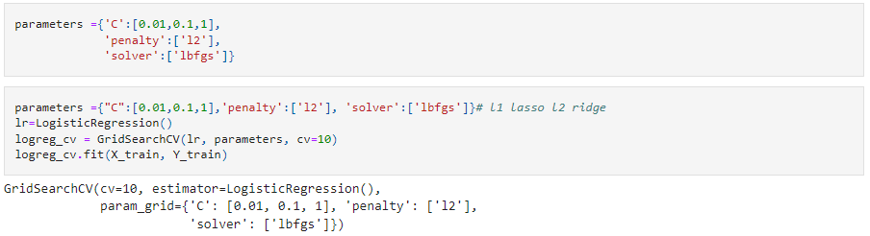
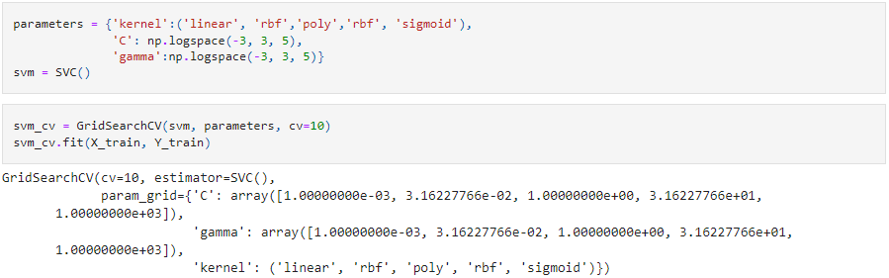
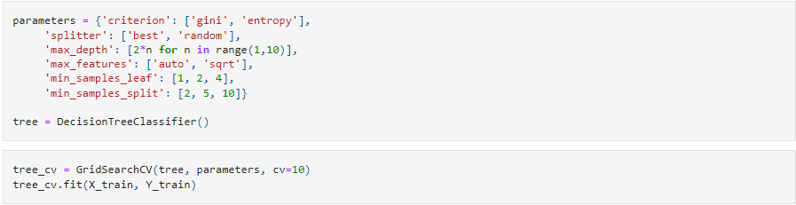
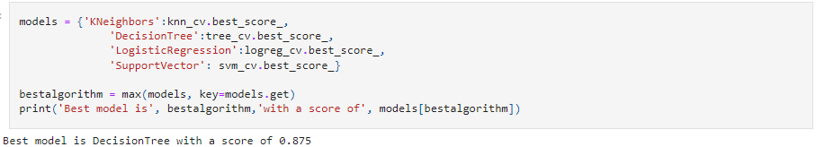
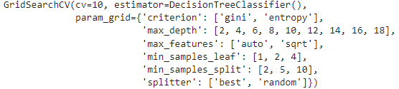
Predictive Analysis (Classification)
After loading the data using Numpy and Pandas, we transformed the data using a Scaler, then split it into Training and Testing groups
After transforming our cleaned data we created 4 different models (Logistic Regression, Decision Tree, SVM, and KNN)
These models were put through a GridSearchCV method to extract the best hyperparameters for each model.
These hyperparameters were then input into each respective model and the accuracies were compared to extract the best performing model
The link to this notebook is: https://github.com/ATrapenard/IBM_AppliedDataScience_Capstone/blob/main/SpaceX_Machine_Learning_Prediction_Part_5.jupyterlite.ipynb

Slide 17
Results
Exploratory data analysis results
Interactive analytics demo in screenshots
Predictive analysis results

Slide 18

Section 2

Slide 19
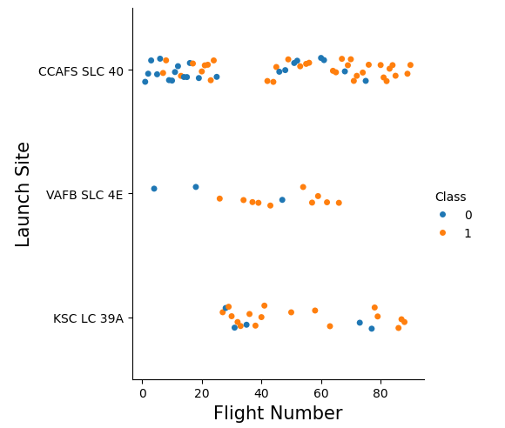
Flight Number vs. Launch Site
Here we can visualize two main interactions
The VAFB Launch Site has experienced the least launches
The Launch Sites that have the lowest success ratio have the fewest flights out of them

Slide 20
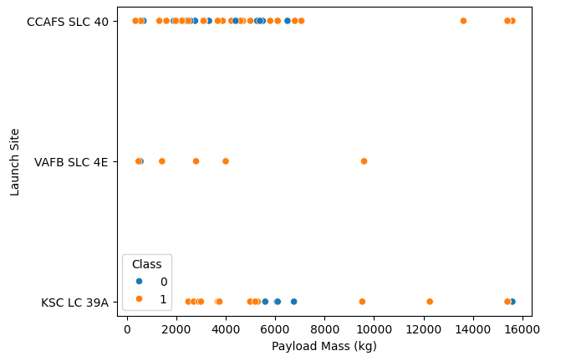
Payload vs. Launch Site
Two main takeaways from this graph
The greater the mass of the payload at Site CCAFS SLC 40 the higher the success rate
Site VAFB SLC 4E has never launched a rocket with a payload over 10000kg

Slide 21
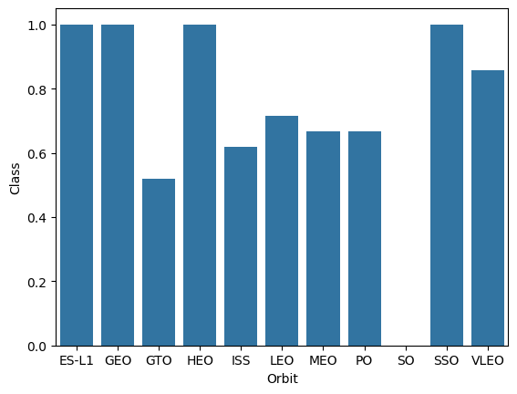
Success Rate vs. Orbit Type
Main takeaways from this graph:
Highest success rate orbits: ES-L1, GEO, HEO, SSO, and VLEO
There seems to be an interaction based on Distance from Earth

Slide 22
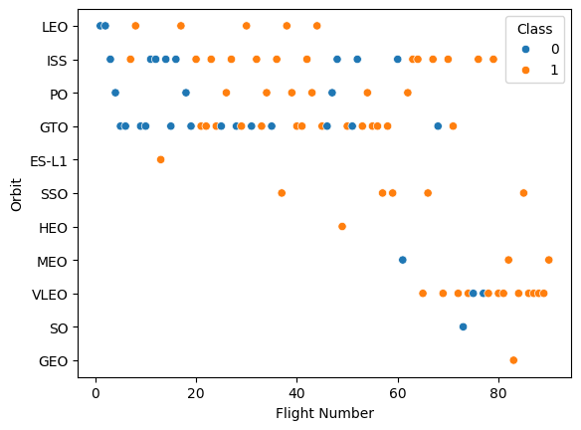
Flight Number vs. Orbit Type
Main takeaways from this graph:
In LEO Orbit, the success rate seems influenced by the number of flights
This trend seems to follow until you reach GTO where there doesn’t seem to be any interaction

Slide 23
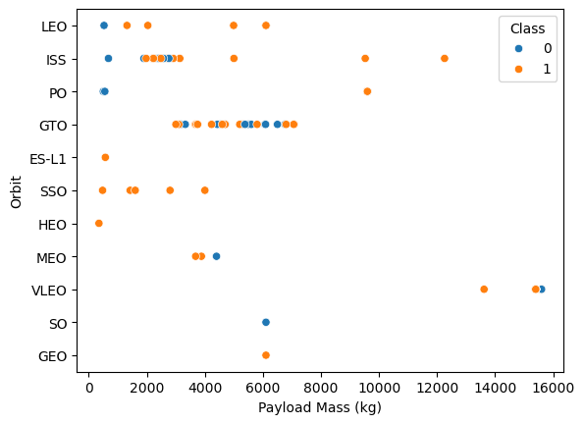
Payload vs. Orbit Type
Main takeaways from this graph:
Polar, LEO, and ISS experienced higher success rates the heavier their Payload was
For GTO, this trend is difficult to analyze because the ratio of successes to failures is exactly 50/50

Slide 24
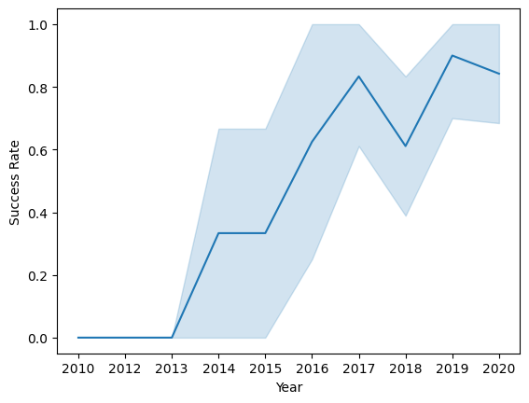
Launch Success Yearly Trend
Main takeaways from this graph:
We can visualize steady increases in success rate from 2013 to 2020

Slide 25
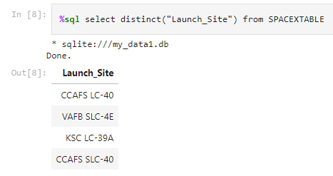
All Launch Site Names
We used the DISTINCT operator to show the unique Launch Sites from the SpaceX Table we previously created

Slide 26
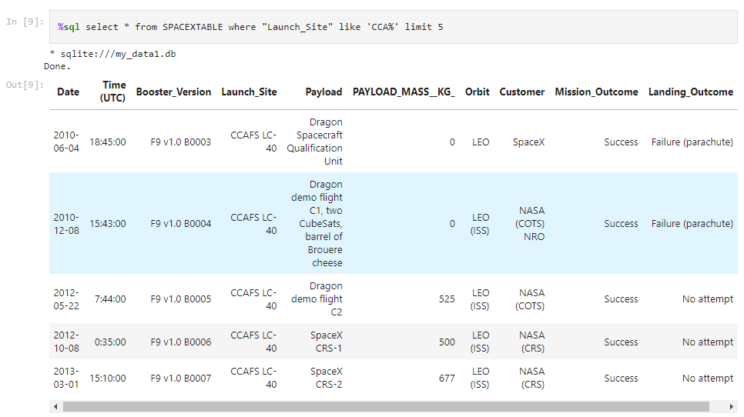
Launch Site Names Begin with 'CCA'
We used the LIKE and LIMIT keywords to output the 5 records where the Launch Site contains the string ‘CCA%’

Slide 27
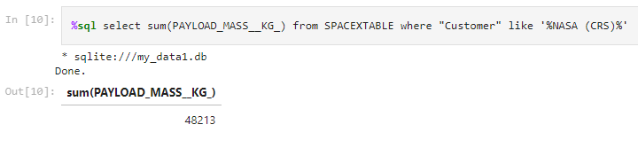
Total Payload Mass
We used the SUM() sub-query alongside LIKE to extract the sum of the payload masses for boosters were launched by NASA (CRS)

Slide 28
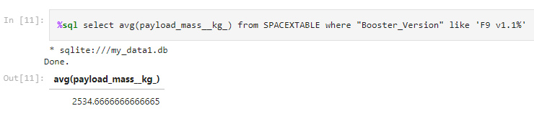
Average Payload Mass by F9 v1.1
We used the AVG() function to calculate the average payload mass for F9 v1.1 Boosters

Slide 29
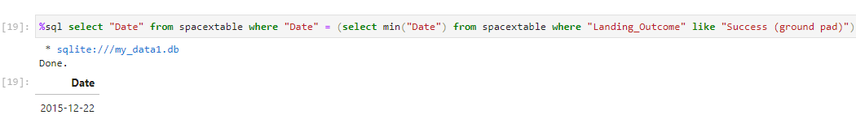
First Successful Ground Landing Date
Here we use the MIN() function to extract the minimum date from the DATETIME objects that satisfy the Success (ground pad) outcome

Slide 30
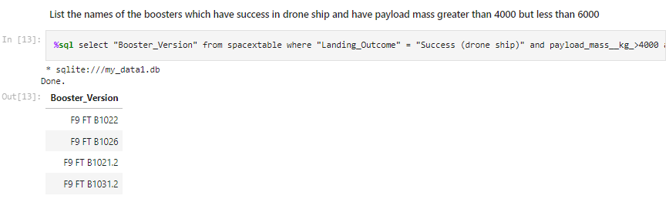
Successful Drone Ship Landing with Payload between 4000 and 6000
We used several AND statements to include the criteria for the payload to be within 4000 and 6000
We also used the WHERE operator to extract only the columns where Landing_Outcome = Success (drone ship)

Slide 31
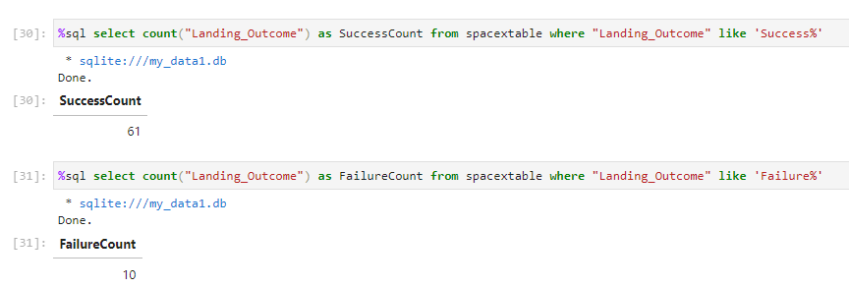
Total Number of Successful and Failure Mission Outcomes
We used the COUNT() function as the main method to count the number of Successes and Failures respectively

Slide 32
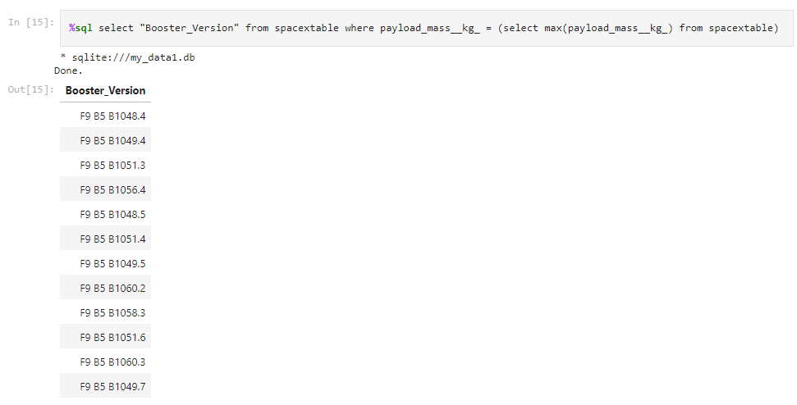
Boosters Carried Maximum Payload
We used a subquery to extract the Max payload
We then filtered the spacextable by Booster Version for only those who have records carrying the Max Payload

Slide 33
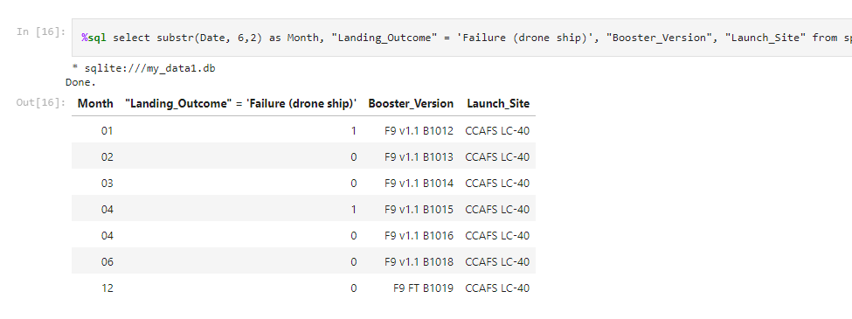
2015 Launch Records
We used the substr() method to extract the Month value from our Dates
We then filtered the dataset to only include those with year values from 2015
Finally, we listed the required categories by filtering the dataset even further

Slide 34
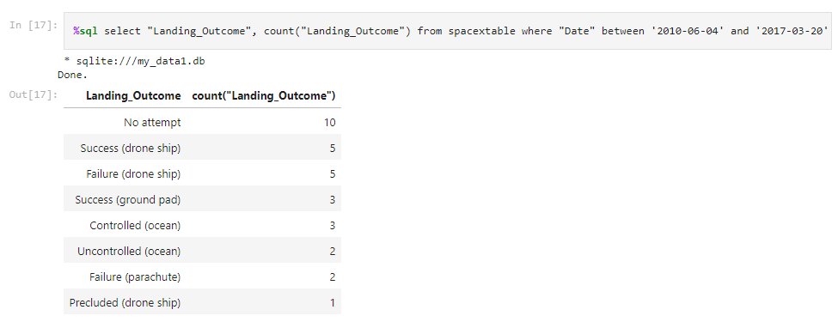
Rank Landing Outcomes Between 2010-06-04 and 2017-03-20
We used the BETWEEN operator and the AND operator to filter this set. BETWEEN was used to filter for our dates and AND was used to join the two DATE values we’re trying to filter based on

Slide 35

Section 3

Slide 36
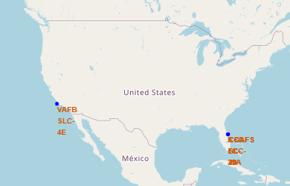
Global Launch Sites
Here we can see that the SpaceX Launch Sites are in the United States clustered on the coasts of California and Florida

Slide 37
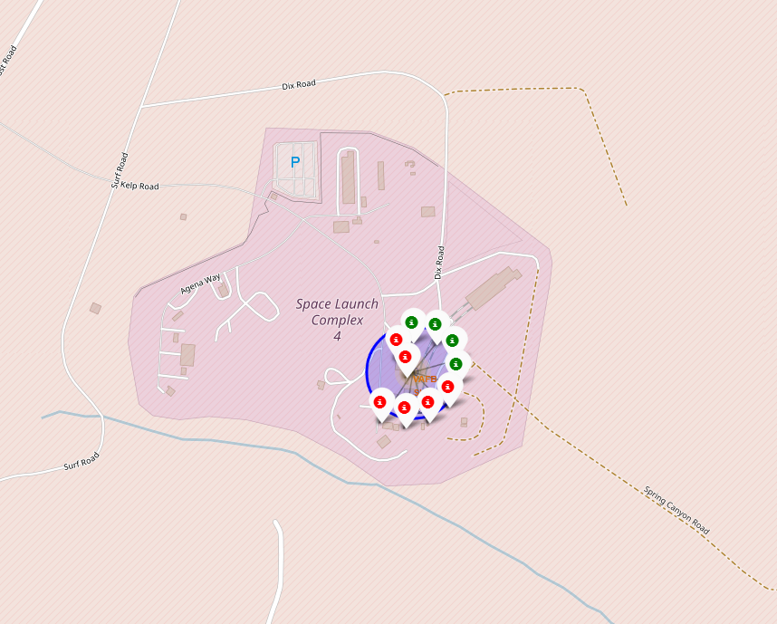
Color Labeled Launch Outcome Marker Clusters
California Launch Site as example
Green Markers show successful Launches
Red Markers show failed Launches

Slide 38
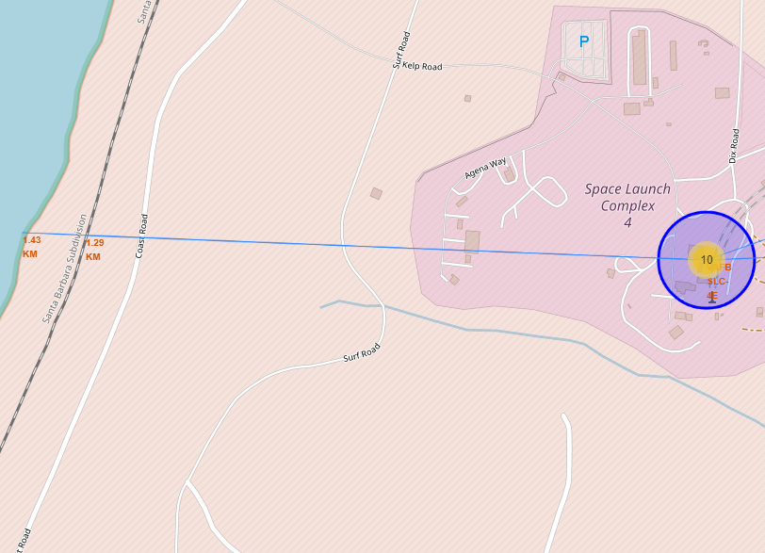
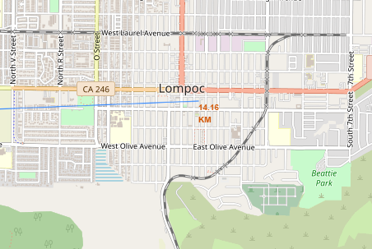
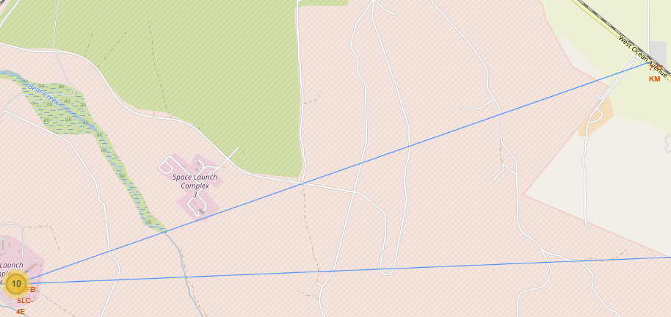
Closest Infrastructure to Launch Sites
Visualized here are the proximity lines that show the distance from the Launch Site to the nearest City, Railway, Coastline, and Highway to answer the questions:
Are launch sites in close proximity to railways? The one in California is
Are launch sites in close proximity to highways? No
Are launch sites in close proximity to coastline? Yes
Do launch sites keep certain distance away from cities? Yes

Slide 39

Section 4

Slide 40
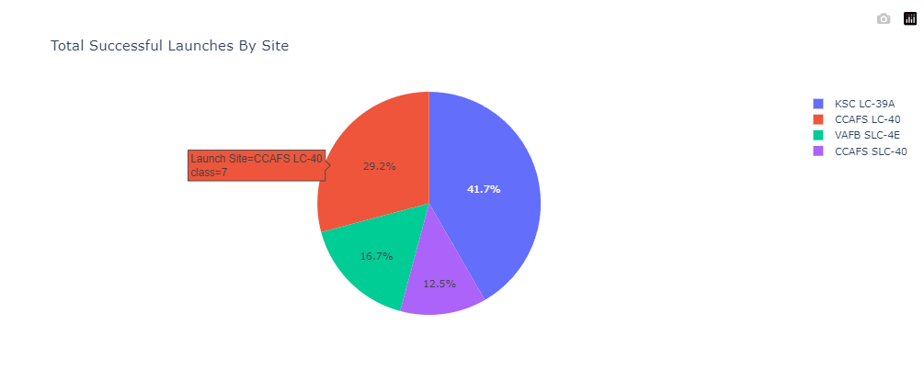
Launch Success Ratio by Launch Site
Here we can see that KSC LC-39A has the highest Launch Success Ratio out of all the Launch Sites
CCAFS SLC-40 has the lowest

Slide 41
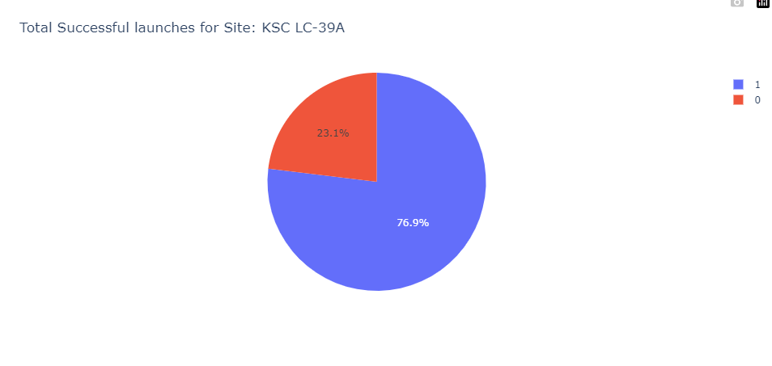
Highest Launch Success Ratio
KSC LC-39A achieved a 76.9% Launch Success Rate and a 23.1% Launch Failure Rate giving it the highest Success Rate among the Launch Sites

Slide 42
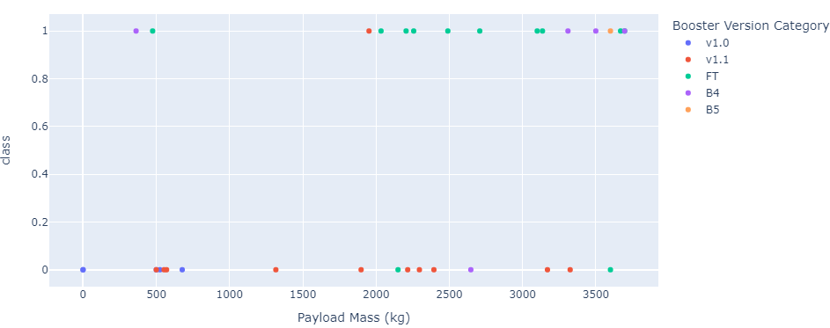
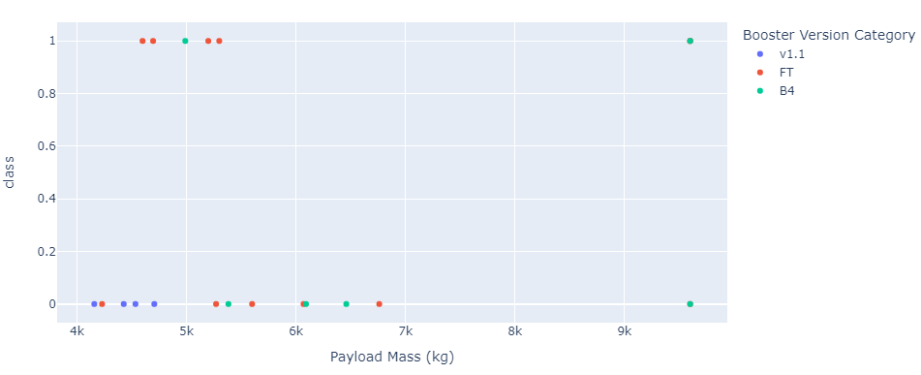
Payload Range vs. Launch Outcome
Light Payload Range: 0-4000kg
Heavy Payload Range: 4000-10000kg
Here we can see that the heavier the mass is, the lower the chance of a Launch Success
We can also see that the FT Booster at low Payload mass has a high success rate but an average success rate at higher Payload masses.

Slide 43

Section 5

Slide 44
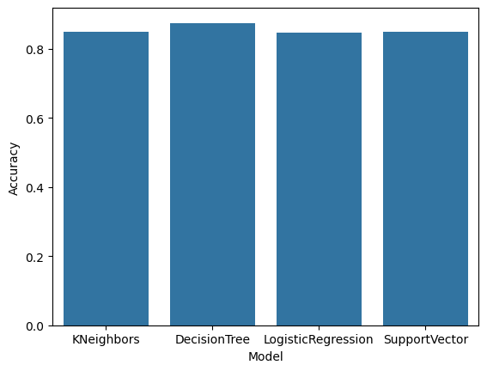
Classification Accuracy
After building, training, and testing the models this bar chart visualizes the Model Accuracy for each tested model
We can see that while all retain a high (80%+) average accuracy, the DecisionTree model has the highest.

Slide 45

Confusion Matrix
This model performs well on classifying True Negatives and True Positives but lacks predictive power when it comes to the False Positives
We can see that the model predicts 1/5th of the landings as Successful that were failures

Slide 46
Conclusions
The lower the Payload Mass (kg) the higher the Success Rate
Yearly Launch Success Rate increased steadily from 2013 to 2020 after which it began to fall off
KSC LC-39A appears to be the most successful Launch Site
Utilizing a DecisionTree classifier is the best tested Machine Learning Algorithm for this predicting Launch Success
Orbits ES-L1, GEO, HEO, SSO, and VLEO had the highest success rate

Slide 47


